Slide 1

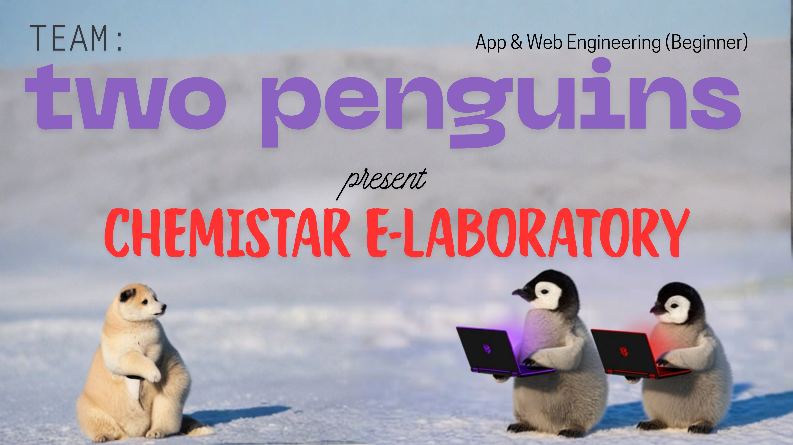
Team: TWO PENGUINS
Track:
App & Web Engineering (Beginner)

Slide 2
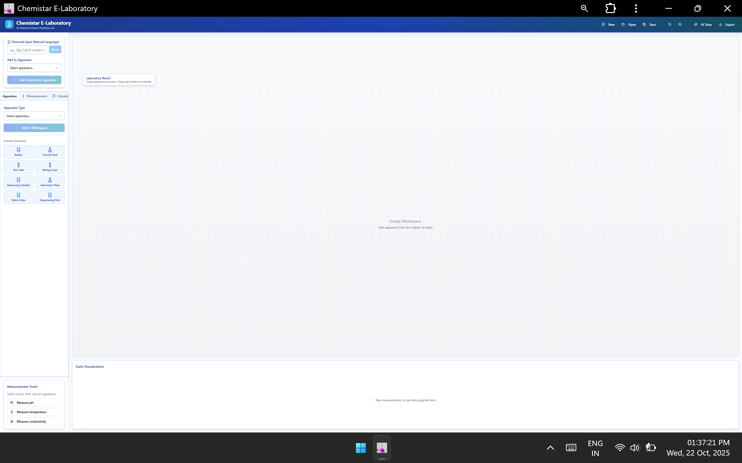
https://chemistar-e-laboratory-4765f69e.base44.app/

Slide 3



















Unlike simulation platforms, doesn’t replay fixed experiments with limited chemicals

Slide 4
Education is not broken. Learning is not broken. But what we do need to do is enlarge the table of people who are consuming range of knowledge. That is how we have to change the system. We have to create experiences that allow us to create opportunities.
Many students lack access to real chemistry labs due to cost or safety constraints. Chemistar makes hands-on experimentation accessible anywhere, removing these barriers and keeping curiosity alive in science learning. Unlike traditional simulation-based platforms that only replay fixed experiments with limited chemicals, Chemistar acts as a true exploratory lab environment. It lets students perform lifelike chemical experiments in a safe, interactive 2D workspace where every reaction, color change, or fume is dynamically predicted by AI based on real chemical properties, not pre-programmed animations.

Slide 5
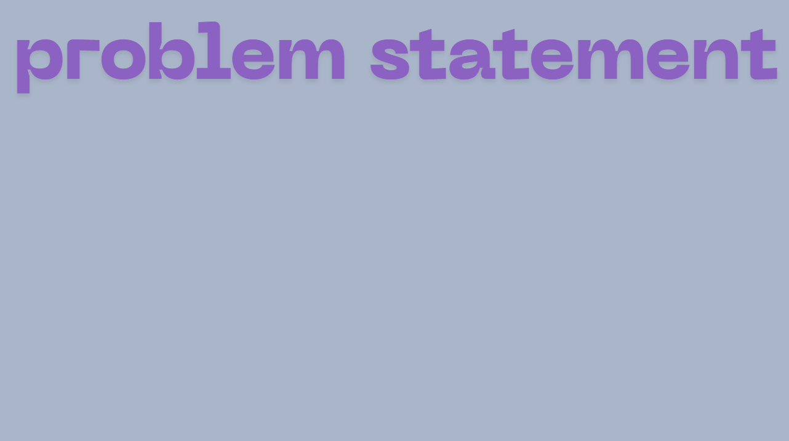







Millions of students lack access to safe, affordable, and fully functional chemistry labs, limiting their ability to explore and learn science through real experimentation with full freedom.

Slide 6
Millions of students lack access to safe, affordable, and fully functional chemistry labs, limiting their ability to explore and learn science through real experimentation with full freedom.
SDG 1 – No Poverty:
By eliminating the need for costly lab infrastructure and materials, Chemistar enables underfunded schools and low-income communities to access high-quality practical science education at no cost. It empowers students from financially constrained backgrounds to gain the same experimental learning opportunities as those in well-equipped institutions, helping break cycles of educational disadvantage.
SDG 4 – Quality Education:
Chemistar transforms theoretical learning or restricted simulation based learning into free hands-on exploration, giving every learner the chance to perform real and innovative experiments safely through an AI-driven virtual lab. It promotes curiosity, engagement, and deeper understanding in chemistry subjects, making high-quality, practical education accessible anywhere, anytime.
SDG 10 – Reduced Inequalities:
By bringing laboratory access to rural, remote, and marginalized students through web and mobile platforms, Chemistar levels the educational playing field. It ensures equal opportunities for scientific learning and experimentation, regardless of geography, gender, or socioeconomic status.

Slide 7
TECHNICAL DETAILS
Languages
Javascript
JSON
Frameworks
React
Tailwind CSS
APIs
base44 Entity (for CRUD)
JSX
CSS
base44 Integration + base44 LLM
Lucide React
Recharts
Desmos

Slide 8
JavaScript:
The primary programming language for all application logic, including frontend interactivity, state management, and interaction with the base44 SDK.
JSX (JavaScript XML):
A syntax extension for JavaScript that allows writing HTML-like code directly within JavaScript files. It's used to define the structure and appearance of React components.
JSON (JavaScript Object Notation):
Used to define the schema for data entities (e.g., Experiment, MeasurementLog) that are stored in the backend database. Also used to specify the expected output format for LLM integrations (e.g., when parsing chemical descriptions or predicting reactions).
CSS (implicitly via Tailwind CSS):
Although not written in separate .css files, the visual styling of the application is achieved through utility classes provided by Tailwind CSS, which ultimately translates to CSS rules.

Slide 9
React:
For building the user interface.
Enables a component-based architecture, making the UI modular, reusable, and easier to manage. React's declarative nature simplifies UI development, and its useState, useCallback, useEffect hooks provide powerful tools for managing component state and side effects.
Tailwind CSS:
For styling the application's user interface.
A utility-first CSS framework that speeds up UI development. By applying pre-defined utility classes directly in JSX, it eliminates the need for writing custom CSS, promotes design consistency, and produces highly optimized stylesheet sizes.

Slide 10
base44.entities.Experiment:
Used for all CRUD (Create, Read, Update, Delete) operations related to Experiment records, such as saving new experiments, listing existing ones, loading, and deleting.
base44.entities.MeasurementLog:
Used to create and persist individual measurement log entries associated with experiments.
base44.integrations.Core.InvokeLLM:
The primary API for interacting with the underlying Large Language Model. Used for natural language parsing of chemical descriptions and for simulating/predicting chemical reactions.
Lucide React:
Provides a library of high-quality, customizable open-source icons used throughout the application for visual cues (e.g., FlaskConical, Save, Beaker, Thermometer).
Recharts:
A charting library for React applications. Used to visualize measurement data (pH, temperature, conductivity) in line graphs within the GraphingPanel.
Desmos Graphing Calculator:
An external web-based graphing calculator embedded directly via an iframe. While not a traditional API integration, it allows the application to leverage Desmos's powerful computational and visualization capabilities for mathematical tasks without building custom functionality.

Slide 11
Base44 Basic Large Language Model (LLM):
Managed and integrated through the base44 platform (specific model/provider abstracted from the application code).
Natural Language Processing (NLP) / Parsing: Interprets free-form text input from the user (e.g., "20g CuSO4 in 50ml water") and converts it into structured JSON data, identifying chemical names, quantities, states, colors, and other properties.
Chemical Reaction Simulation / Prediction: Analyzes the structured data of chemicals mixed in an apparatus and predicts the outcomes of potential chemical reactions. This includes determining if a reaction occurs, color changes, temperature changes, formation of gases or precipitates, and the identity of reaction products.

Slide 12

STUDENTS
STUDENTS
~100% accessibility
(rural/underfunded schools)
(urban schools)
Higher scores
Greater curiosity
realistic lab experiences
+
UNRESTRICTED PRACTICAL LEARNING
FREEDOM IN LABoRATORY
---------
No prevention of experiments
Easier learning
Stronger learning
More learning

Slide 13
who benefits and why it matters:
Students in rural or underfunded schools gain access to realistic lab experiences previously limited to well-equipped institutions due to location OR funding. Students in urban schools with labs can perform experiments often not allowed, due to "silliness" or "waste of money", like mixing acid base indicators or due to safety, like cesium and water. also, young students who get an interest in the stem or chem from just curiosity can broaden and nourish the curiosity to be more innovative in the future.
measurable outcomes:
Increased accessibility — 100% of students with a phone or computer can perform virtual experiments safely.
Expanded learning outcomes, measured by higher test scores, curiosity-based learning metrics, and independent project participation, not only due to more knowledge, but due to knowledge being funner to acquire, and easier to remember.

Slide 14

Integrate Chemical Databases
Have students try to predict reaction
Get into physics
Add Gamified Leaderboard
Improve realism
AR-Enhanced Physical Experiments
Allow users to perform experiments offline using real-world placeholders like water and rocks in beakers
The system will use AR tracking and camera feed modification to visualize the actual chemical reactions on screen.
Collaborative labs
Guided experiments
Data analytics for schools

Slide 15

Problem: Many students can’t perform experiments freely to learn chemistry.
Solution: Chemistar lets anyone perform almost any realistic virtual experiments safely on almost any device.
Impact: It makes hands-on science learning accessible, equal, and valuable for all.

Slide 16


